Slide 1
A Brief MATPLOTLIB API Primer
Let’s Unlock The World of Visualization.

Slide 2
TABLE OF CONTENTS
01
03
02
04
Justification of
The Topic
MATPLOTLIB Basics
Intro to MATPLOTLIB
Types of Plots

Slide 3
TABLE OF CONTENTS
05
06
07
Best Practices of DATA VISUALIZATION
Real World Applications
Conclusion

Slide 4

INTRODUCTION
This Unit Offers us a visual journey through the world of Data Visualization in Python thru MATPLOTLIB.
It introduces Matplotlib, a versatile library for creating plots, charts, and graphs, making it a valuable tool for analysts, scientists, and data enthusiasts.

Slide 5
—JACK YOUNGBLOOD
"I visualize things in my mind
before I have to do them. It’s like having a mental workshop."

Slide 6
01
JUSTIFICATION OF THE TOPIC

Slide 7
ABOUT THIS TOPIC
A "Matplotlib API Primer" refers to an introductory guide or documentation that provides an overview of the Application Programming Interface (API) offered by Matplotlib.
This primer serves as a starting point for users who want to learn how to use Matplotlib for creating various types of plots and charts in Python.

Slide 8
Parts of The API
Intro to Matplotlib
Usage of The API
Customization
Advanced Features
It introduces Matplotlib as a powerful data visualization and plotting library.
It explains how to use Matplotlib's API for creating different types of plots.
Customize the appearance of plots, including labels, colors, legends, and other visual elements.
The primer may also touch upon advanced features of Matplotlib, like creating subplots and annotations.

Slide 9
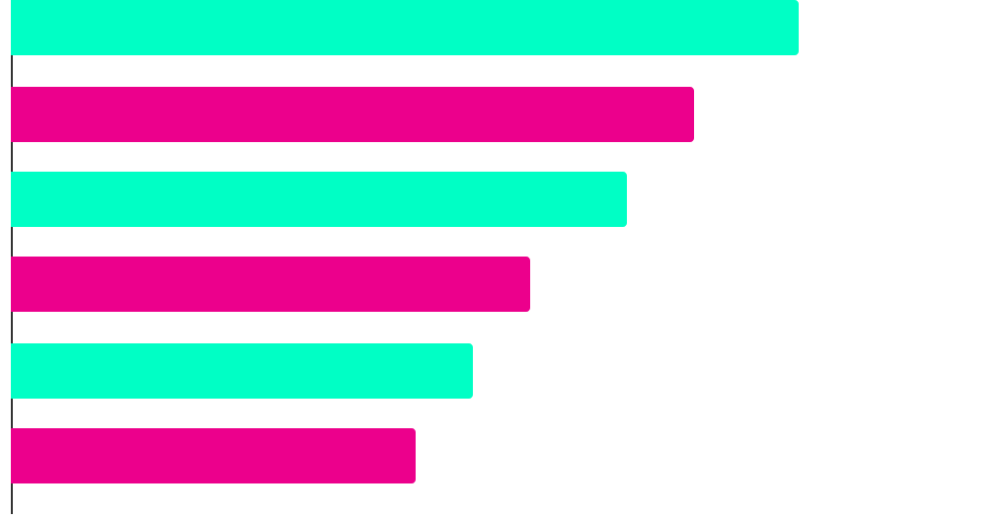
DID YOU KNOW THIS?
R
PYTHON
JAVASCRIPT
MATLAB
JAVA
C / C++
Top Programming Languages for Data Visualization
which Compete for the Top Spot

Slide 10
02
INTRODUCTION TO MATPLOTLIB

Slide 11
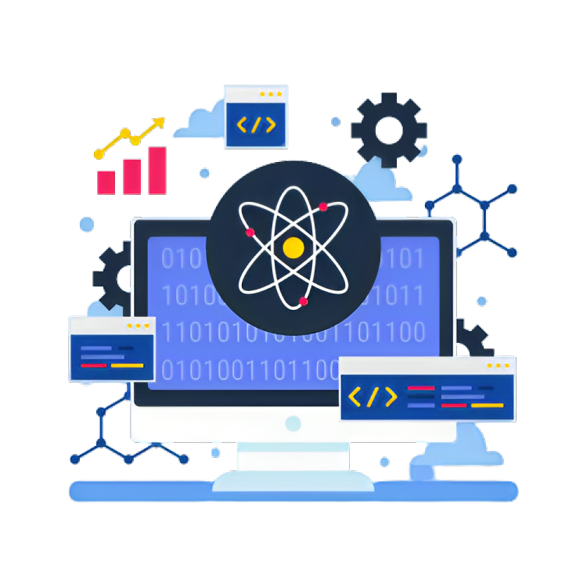

ABOUT THE TOPIC
Matplotlib is a widely-used data visualization library in Python that provides a comprehensive set of tools for creating a wide range of static, animated, and interactive plots and charts.

Slide 12
Importance of DATA VISUALIZATION
Understanding Data: Visual representations of data make complex datasets more understandable, allowing you to identify trends, patterns, and outliers.
Effective Communication: Data visualizations are powerful tools for conveying insights to stakeholders, making it easier for non-technical audiences to grasp the data's significance.
Decision-Making: Visualizations assist in data-driven decision-making by presenting information in a clear and actionable format.

Slide 13
MATPLOTLIB as a Powerful Library
Versatility
Customization
Integration
Matplotlib supports a wide variety of chart types.
It provides extensive options for customizing the appearance of plots, allowing you to fine-tune
Matplotlib seamlessly integrates with other data science libraries like NumPy and Pandas.

Slide 14
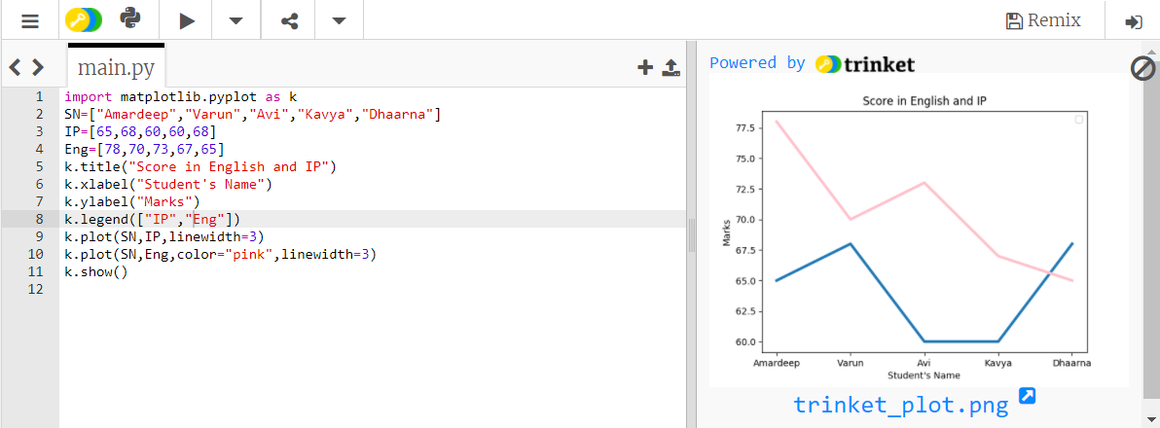
A Depiction of a LINE CHART using MATPLOTLIB

Slide 15
03
MATPLOTLIB BASICS

Slide 16
What are The BASICs?
1) Figure:
The Figure is the top-level container for your plots. It can be thought of as the canvas on which you create your visualizations.
It encompasses the entire graphical window or page.
A single Figure can contain one or more subplots (Axes).
2) Axes:
Axes represent individual plots or subplots within a Figure.
Each Axes is a separate area where you can create visualizations such as line plots, bar charts, scatter plots, etc.
Multiple Axes can be placed within a single Figure, allowing you to arrange and display multiple plots together.

Slide 17
04
TYPES OF PLOTS

Slide 18
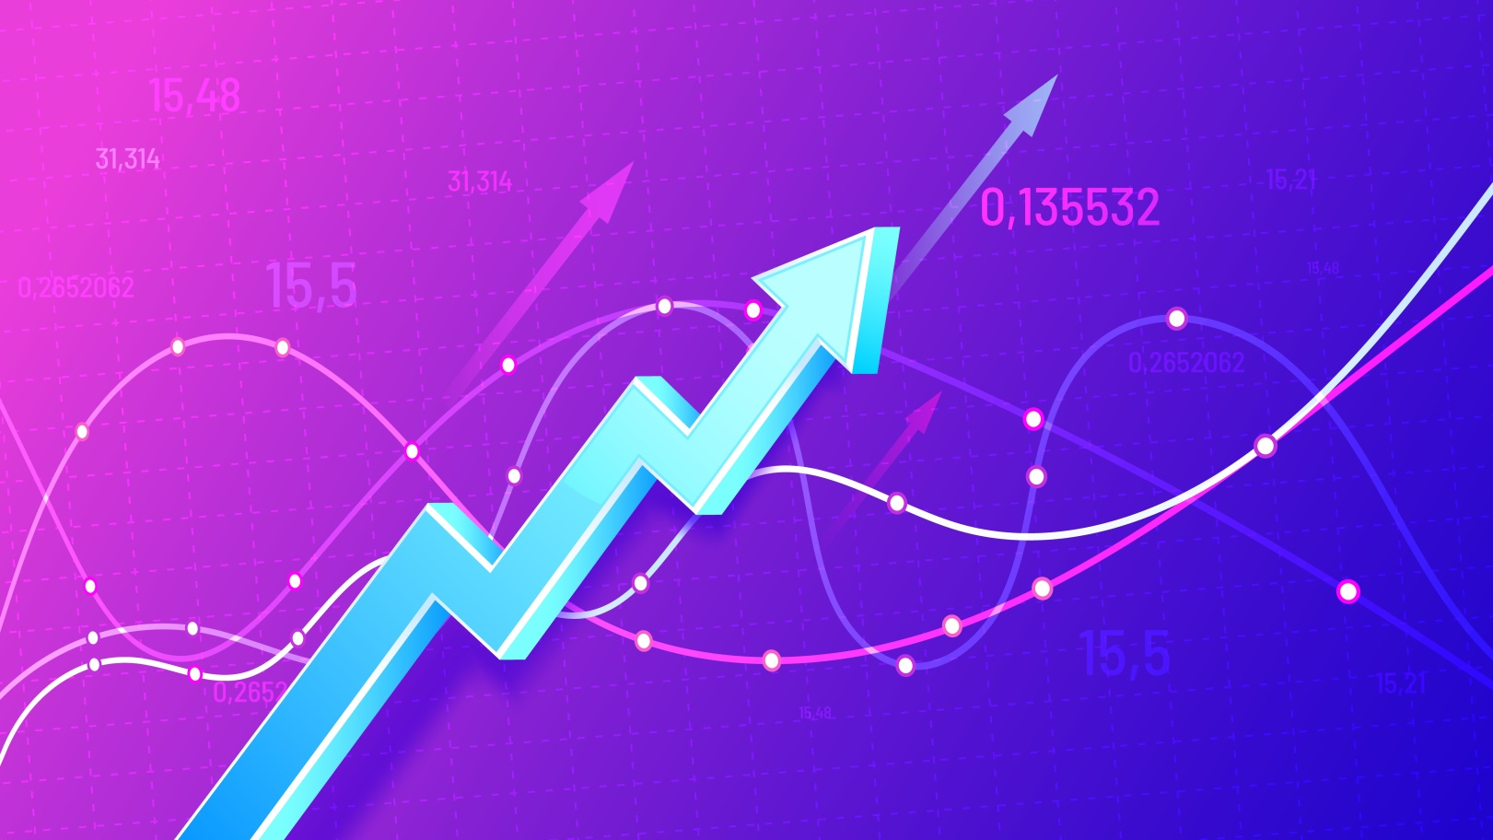
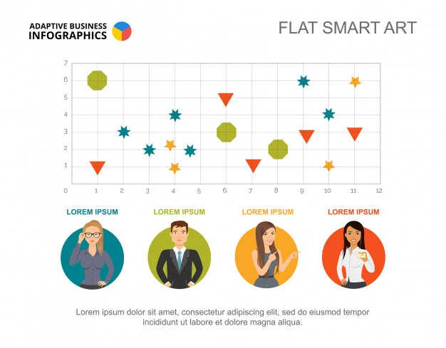
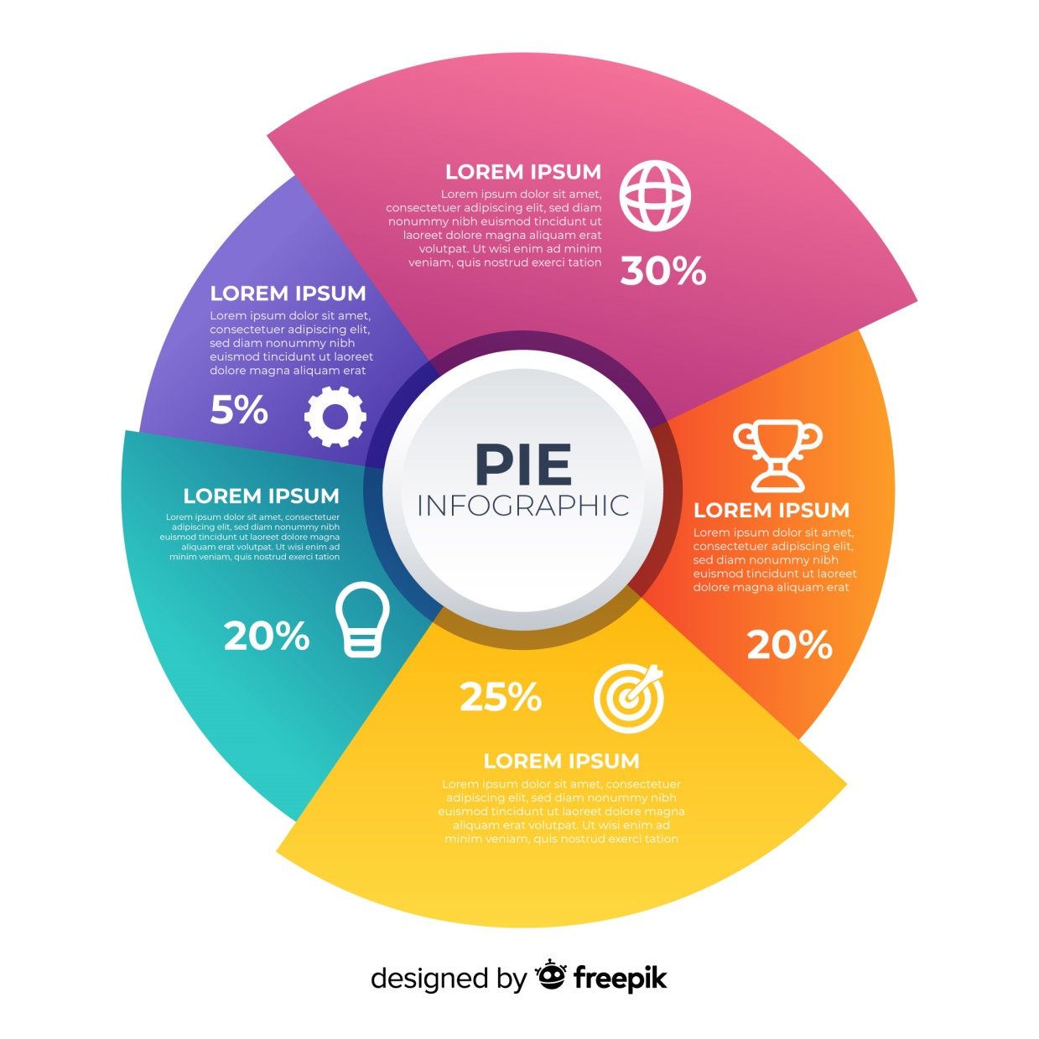

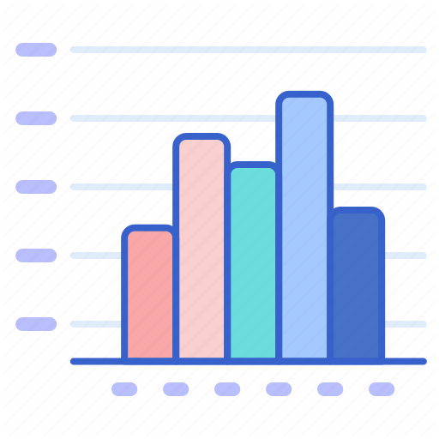
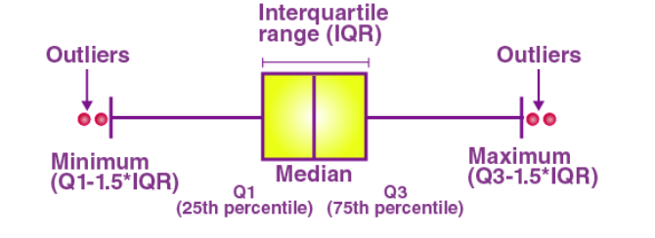
Line Chart
Scatter Plot
Pie Chart
Some Types of Charts
Bar Chart
Histogram
Box Plot

Slide 19

Visualization is daydreaming with a purpose

Slide 20
05
Best Practices of DATA VISUALIZATION

Slide 21

Solution
Problem
Just a Couple of HARD & FAST tips.
Difficult to Understand & Comprehend.

Slide 22
OVERVIEW DIAGRAM
Simplicity
Clarity
Principles for Effective
Relevance
Consistency
Keep visualizations simple and uncluttered
Ensure that the Data is presented clearly and easily understood
DATA VISUALIZATION
Select the right data and visuals to convey the intended message
Maintain a consistent style throughout your visualizations

Slide 23
06
Real World Applications

Slide 24

Some Applications of MATPLOTLIB in Real - World
Scientific Research
Engineering
Astronomy
Biological Research
Environmental Sciences
Structural Analysis
Simulations
Quality Control

Slide 25



Healthcare
Education
Medical Imaging
Epidemiology
Patient Data Analysis
Teaching & Learning
Student Projects
Finance
Stock Market Analysis
Portfolio Management
Economic Trends

Slide 26
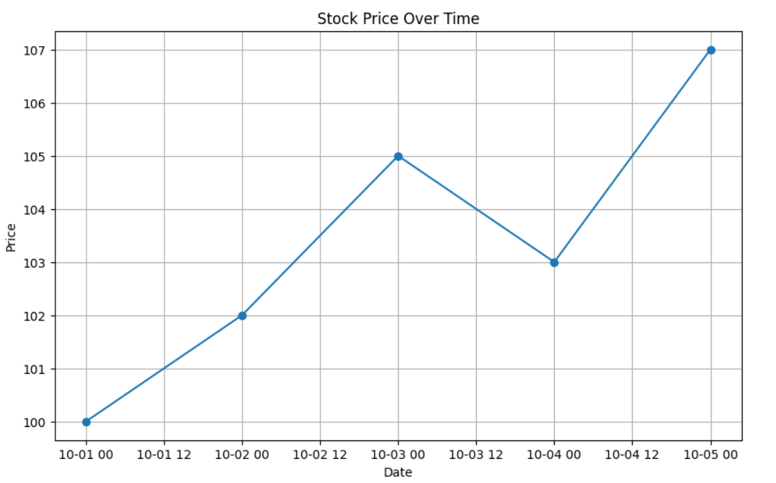
A Small Snippet of MATPLOTLIB used in Stock Market.

Slide 27
07
Conclusion

Slide 28
PRESENTATION TIMELINE
Matplotlib, a widely-used Python library, offers versatile tools for creating static, animated, and interactive data visualizations.
Line Chart, Scatter Plots, Pie Charts, Histograms, Bar Graphs, Box Plots, etc.
Introduction
Types of Plots
01
02
03
04
API Primer
Basics
A "Matplotlib API Primer" is an introductory guide that provides an overview of Matplotlib's API, helping users start creating plots and charts in Python.
The Figure is the top-level container for plots, acting as a canvas for visualizations, while Axes are individual areas for creating various plots within a Figure, enabling multiple plots in one Figure.

Slide 29

PRESENTATION TIMELINE
Scientific Research spans Astronomy, Biological Research, Environmental Sciences, Engineering, Healthcare, Education, and Finance, which includes Stock Market Analysis, Portfolio Management, and Economic Trends.
Real World Applications
05
06
EOL ---------------->
Best Practices
Balancing simplicity, clarity, relevance, and consistency is key to effective data visualization.

Slide 30

THANKS!
For Being A Patient Listener !!
1) Sahaj Khurana 224019
2) Harnoor Singh Anand 224028

